Slide 1
Vk Project
By Romanov Alexey

Slide 2
Network summary
Used VK API
Nodes 1190(at biggest component 985)
Edges 5667
Diameter 10
Radius 6
Av clustering 0.38
Av shortest path 4.31

Slide 3
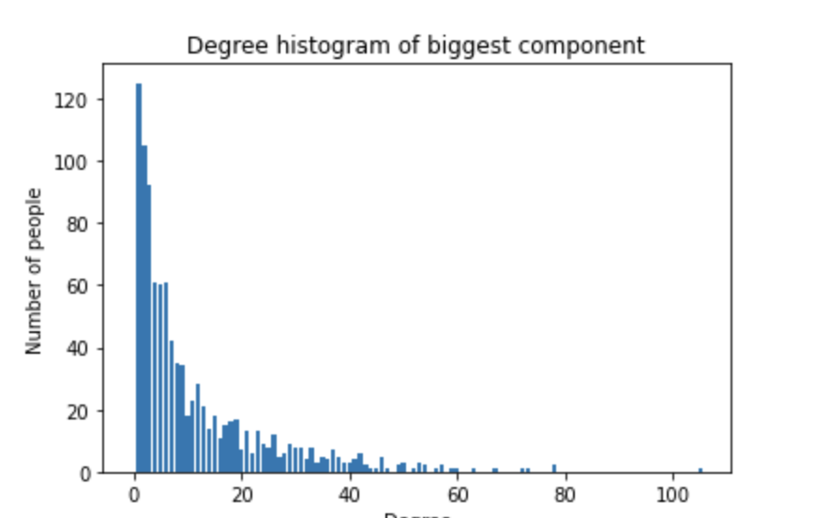
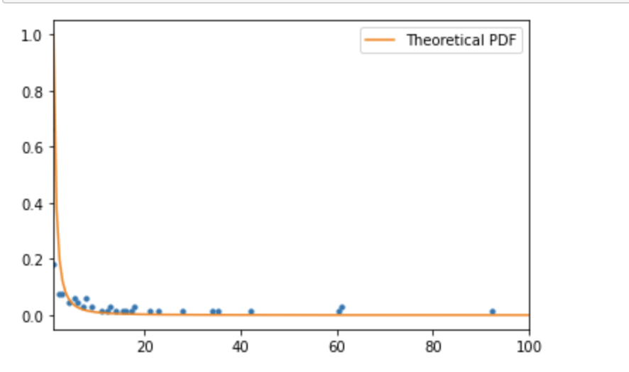
Degree histogram
For the big component the same degree structure occurs.
Next, I will drop vertexes, with degrees < 3. The structure of main clusters will stay the same.
Degree histogram has the structure like theoretical pdf of power law. With alpha = 2

Slide 4
Assortativity coefficient
By sex: 0.10816
By city: 0.092229
By degree: 0.178
As coefficients are not big, there are no assortativity patterns.

Slide 5
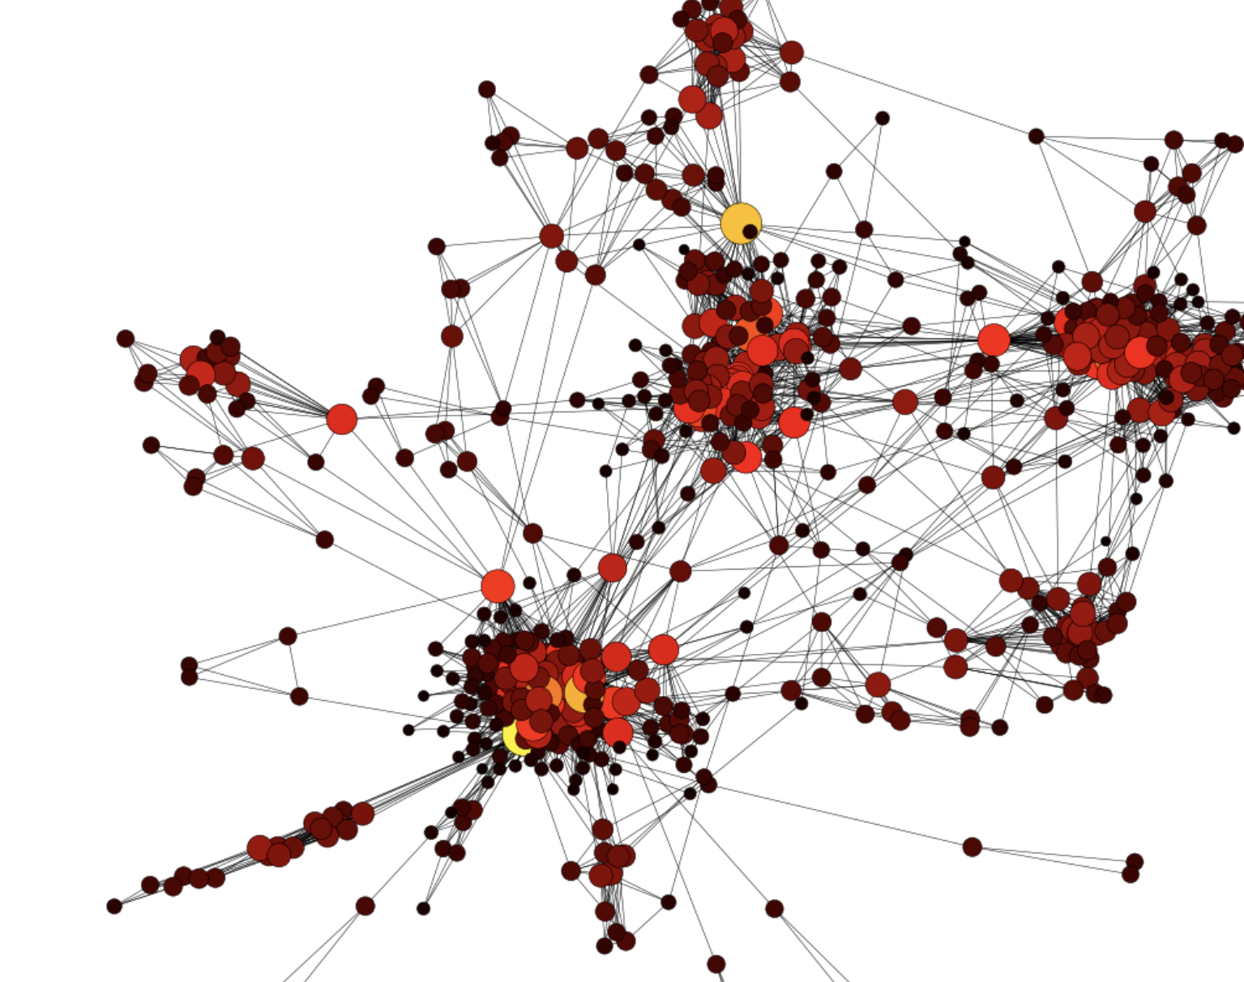
Graph of biggest component
5 main clusters:
Bachelor mates
Lyceum mates
Freelance
School
- Different activities cluster – business activities, self-development

Slide 6
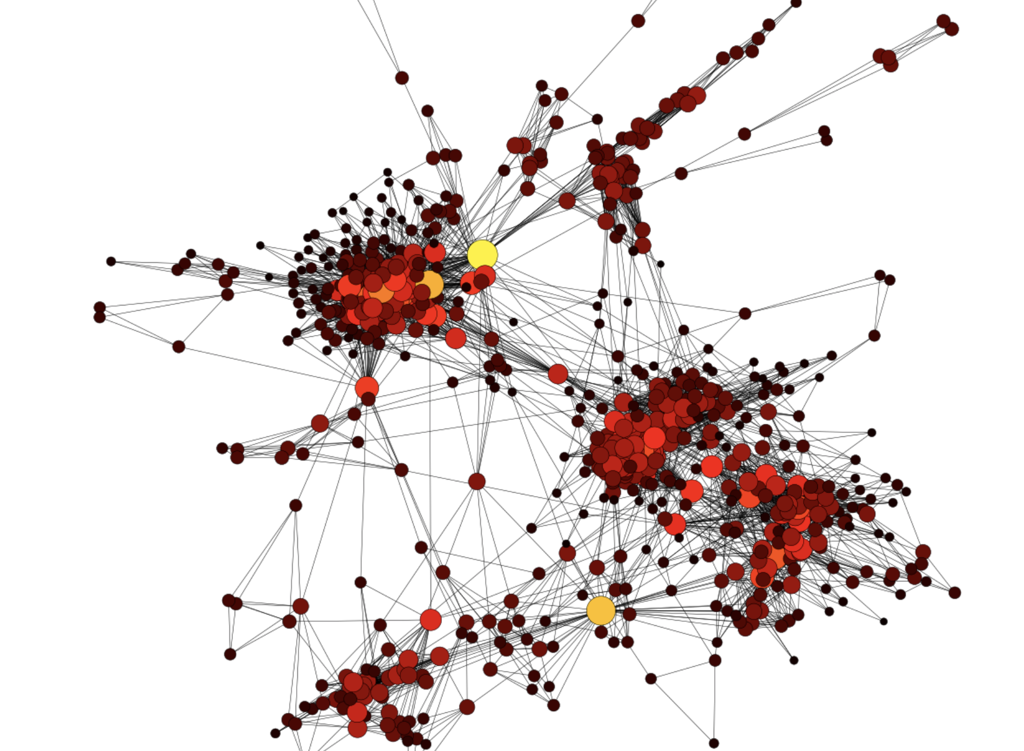
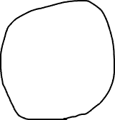
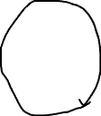
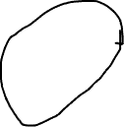
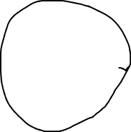
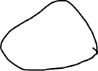

Slide 7
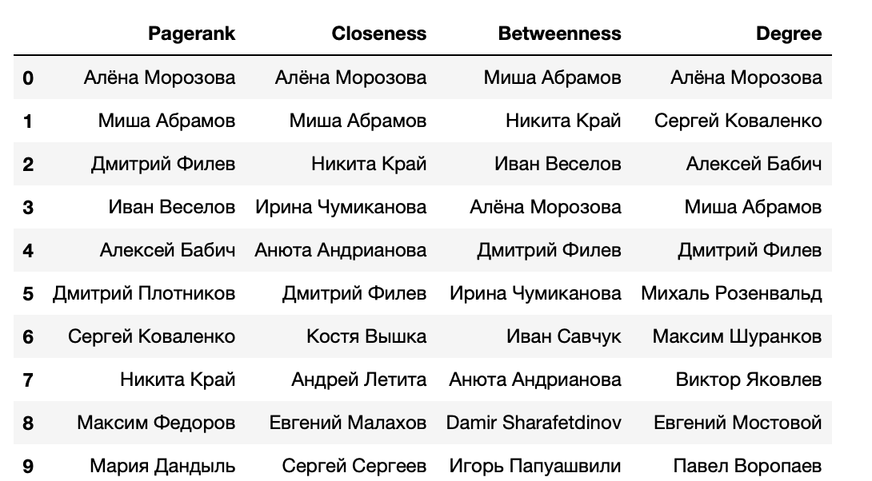
Centralities
Алена Морозова – creator of freelance chat
Миша Абрамов/Дмитрий Филев/Дмитрий Плотников –one of the biggest посредников in Freelance
Иван Веселов –me friend from school, has connections with mates in HSE, in self-development and gym
Damir – I was his tutor at math, then he reccomended me to many people in ГУУ, than explained to his classmates calculus and theory probability.
Михаль Розенвальд – classmate from HSE Bachelor
Иван Савчук – author in finance disciplines, sent many orders to him

Slide 8
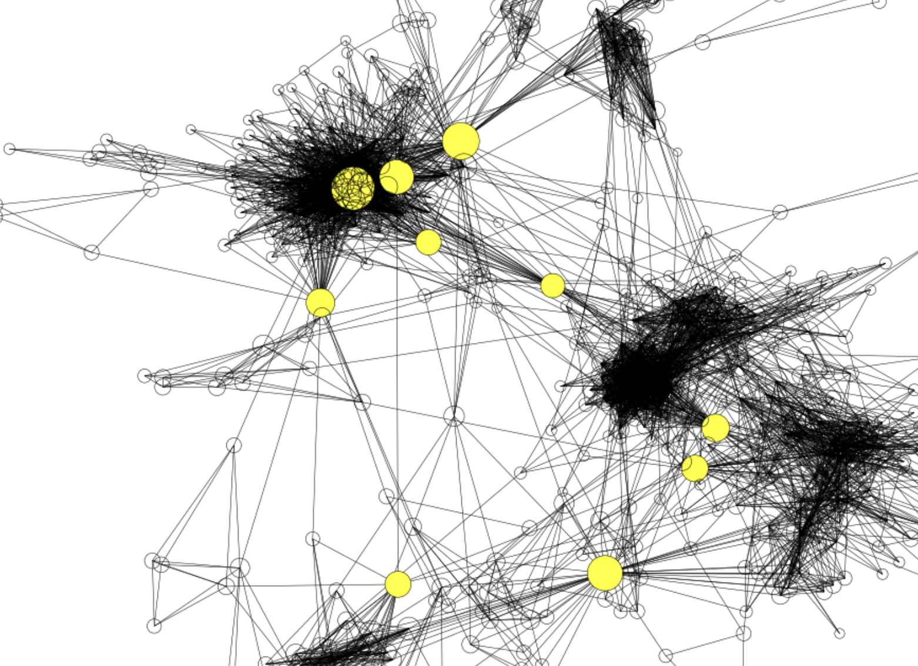
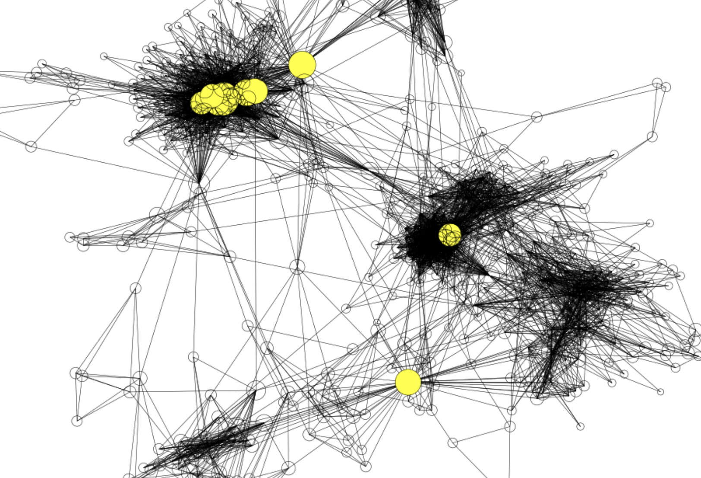
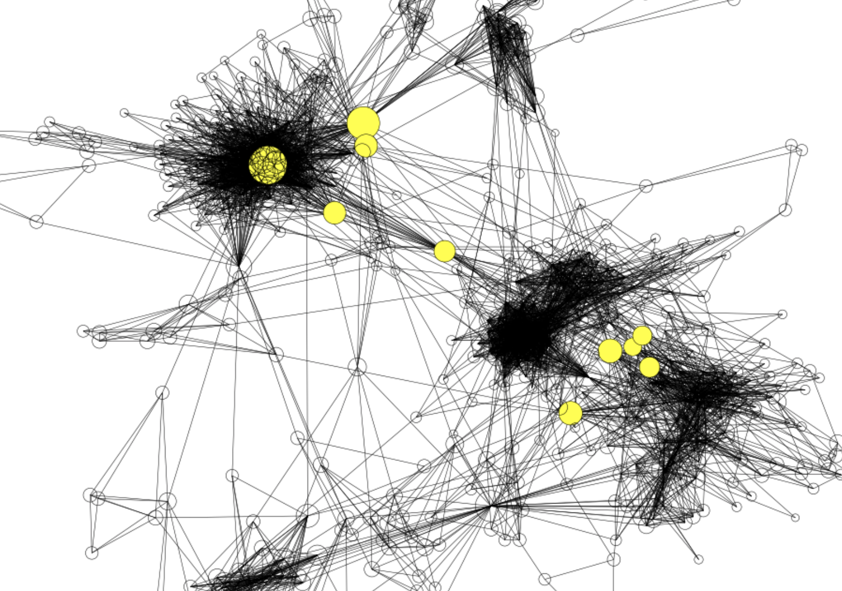
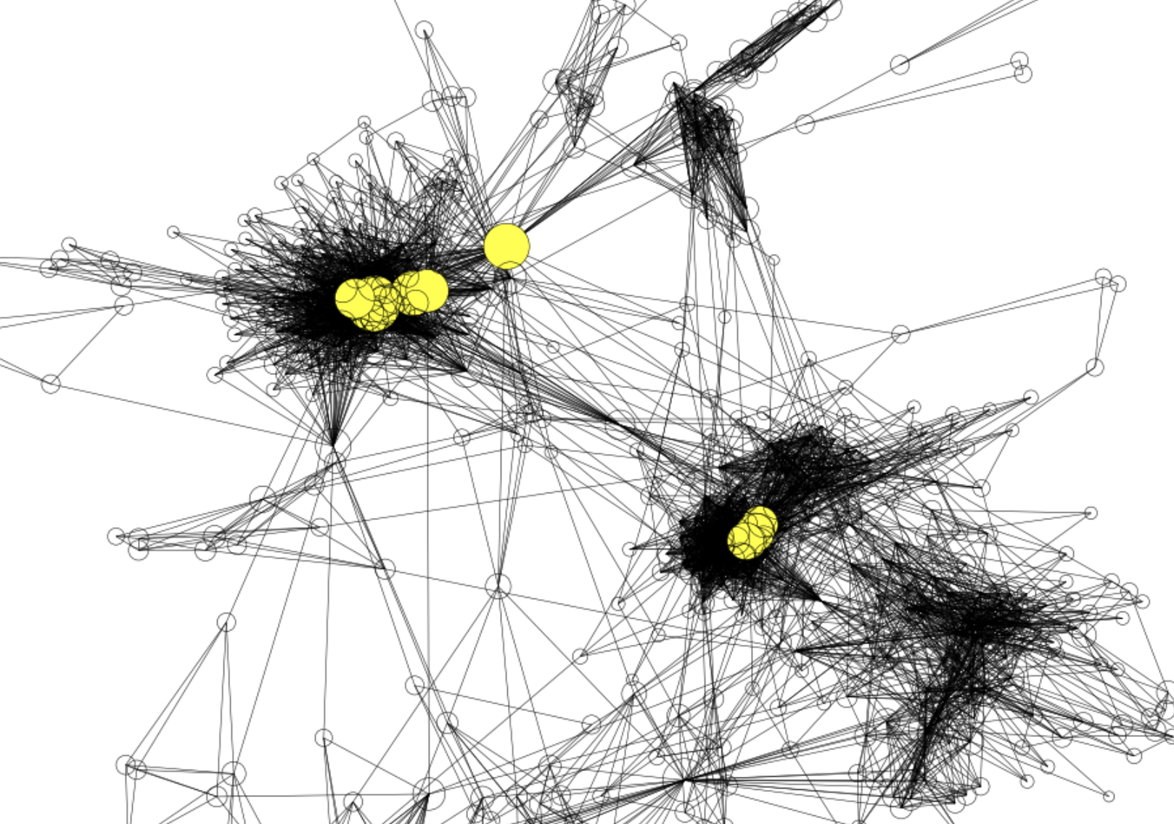
Pagerank Top-nodes
Top nodes betweenness
Top friends closeness
Top-friends degree

Slide 9
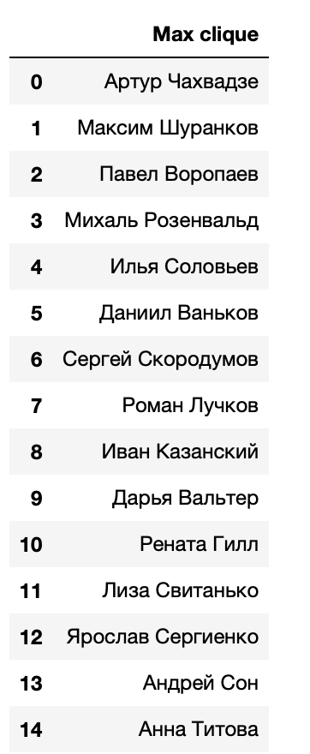
Maximal clique
15 person in max clique.
All from HSE Bachelor – FCS applied maths and
Informatics.
10 of them are my mates from group. Others are
from different groups.

Slide 10
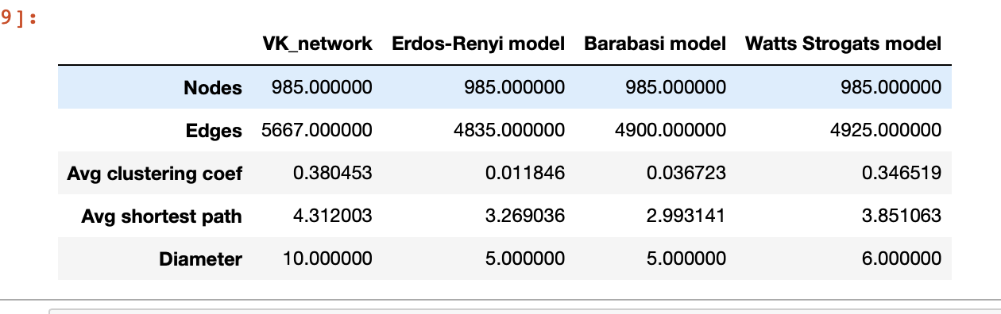
Comparison with other graph models
VK network looks very similar to Watts-Strogats model, because avg shortest is the same and avg clustering coef.

Slide 11
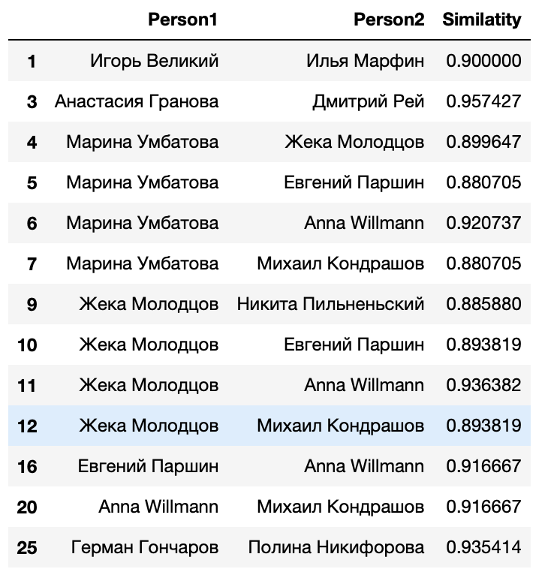
Similarity
4-7 guys from my lyceum,one group
9-20 guys from lyceum, another group
20 – couple In lyceum
3- guys, to whom I explained maths

Slide 12
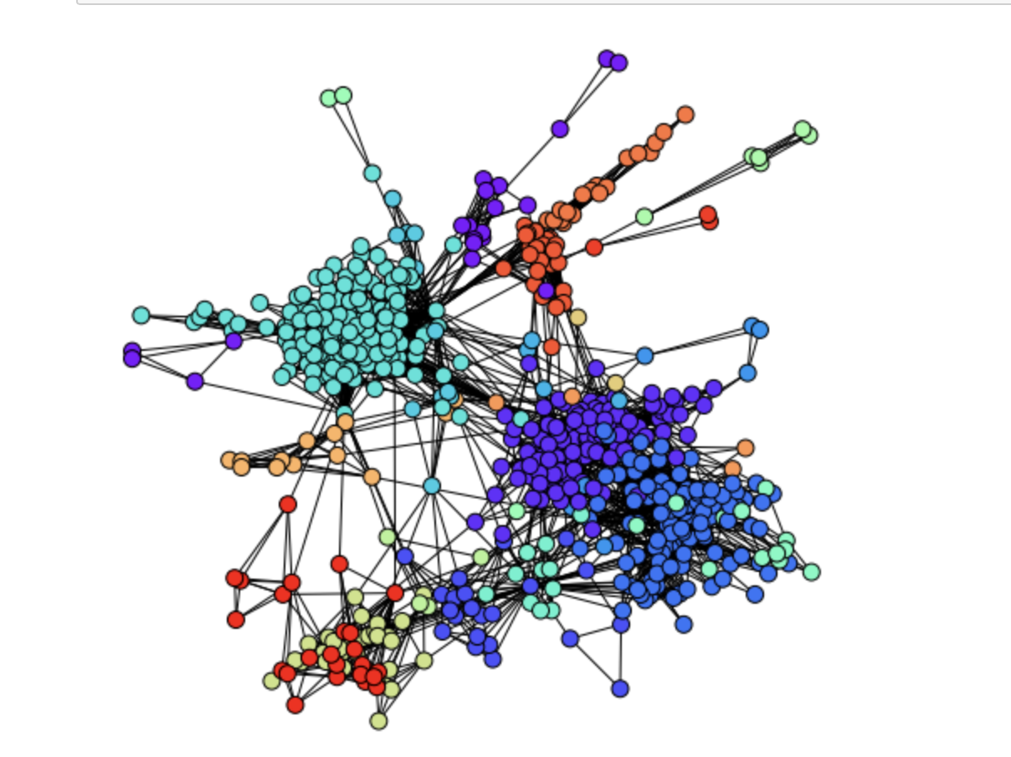
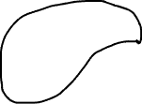
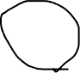

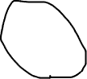
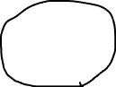

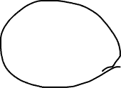
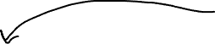
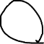
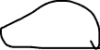
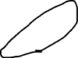
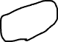
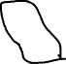
Agglomerative clustering.
Showed nice
Results.
Many clusters,
which are
Interpretable.

